Slide 1
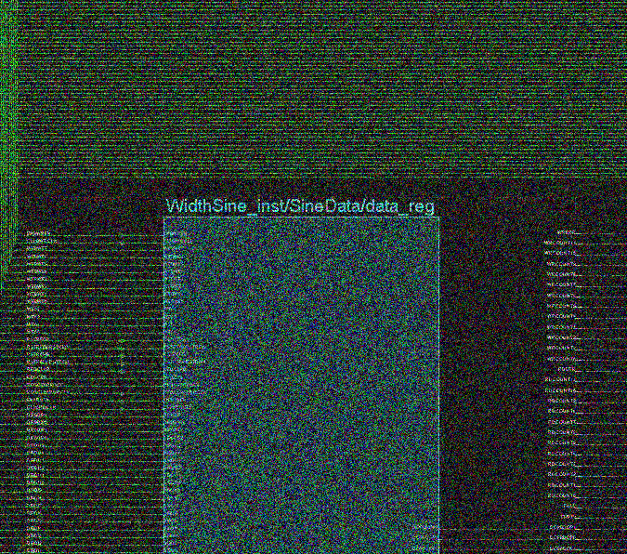
Wave synthesis with field programmable gate array
charles

Slide 2
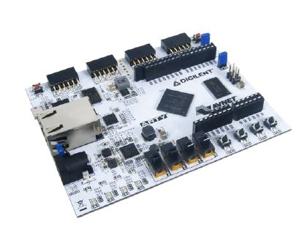
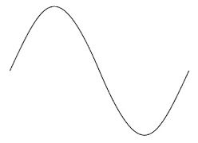
charles
?

Slide 3
General scheme
EN
PWM
ANALOG INTERFACE
V_{out}
PLL
ROM
BINARY COMPARATOR
COUNTER
DAC
V_{out}
TICK GENERATOR
SHIFT REGISTER
INTERFACE LOGIC
CLK

Slide 4

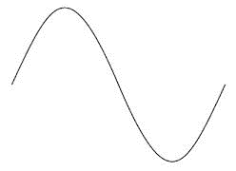
pwm
???

Slide 5
Vai giulia

Slide 6
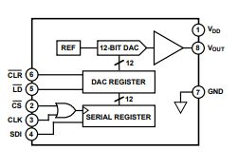
DAC

